Slide 1



Connecting QAT & ARTMIS shipment data
Q A T
Problem: We need a way to link QAT & ARTMIS shipment data
Currently, ARTMIS does not have a unique identifier for shipments from RO creation to delivery
A: QAT line level tag in ARTMIS, approved mandatory at RO entry (best case)
1. Supply Planner plans shipments¹ in QAT
2. Procurer places RO
(tagging header to QAT supply plan & line-level to QAT shipment ID)
3. PSM GSC procurement process
(data flows from WCS to OMS², source determined, vendor-specific SKU assigned, etc)
4. All – see live status updates in QAT
(ARTMIS data shown in QAT, Original QAT planned data hidden)
Input in:
WCS RO Creation
Mandatory at:
Modifiable up to:
???
Validated at:
PO stage
USAID approval stage= ??
¹ Each QAT shipment is one delivery date
² Tagging Data is not editable after enters OMS (RO approved by USAID

Slide 2
Connecting QAT & ARTMIS shipment data
Q A T
Problem: We need a way to link QAT & ARTMIS shipment data
Currently, ARTMIS does not have a unique identifier for shipments from RO creation to delivery
A: QAT line level tag in ARTMIS, approved mandatory at RO entry (best case)
1. Supply Planner plans shipments¹ in QAT
2. Procurer places RO
(tagging header to QAT supply plan & line-level to QAT shipment ID)
3. PSM GSC procurement process
(data flows from WCS to OMS², source determined, vendor-specific SKU assigned, etc)
4. All – see live status updates in QAT
(ARTMIS data shown in QAT, Original QAT planned data hidden)
Input in:
WCS RO Creation
Mandatory at:
Modifiable up to:
???
Validated at:
PO stage
USAID approval stage= ??
C: ARTMIS creates parent line ID (2nd best)
1. Supply Planner plans shipments¹ in QAT
2. Procurer places RO
(tagging header to QAT supply plan)
3. Supply Planner links QAT & ARTMIS shipments
4. PSM GSC procurement process
(data flows from WCS to OMS², source determined, vendor-specific SKU assigned, etc)
5. All see live status updates in QAT
(ARTMIS data shown in QAT, Original QAT data hidden)
¹ Each QAT shipment is one delivery date
² Tagging Data is not editable after enters OMS (RO approved by USAID
B: QAT line level tag approved mandatory at RO verification (3rd best)
Same as option A, with line-level tag mandatory at RO verification stage

Slide 3
Connecting QAT & ARTMIS shipment data
Preferred
 | Option A: QAT line level tag in ARTMIS, approved mandatory at RO entry | Option B: QAT line level tag in ARTMIS, approved mandatory at RO verification | Option C: ARTMIS creates parent line ID
Unique ID | QAT shipment ID | QAT shipment ID | ARTMIS RO & prime line #
Who matches/tags? | Procurer | Procurer / PSM HQ? | Supply Planner
Pros | Easier to add auto-RO creation feature in future Easier for supply planner to associate supply plan with ARTMIS | Possibly less time for user at RO creation stage | Less time for user at RO creation stage.
Cons | More time at RO creation. | Relies on GSC HQ knowledge of QAT information. More time during RO validation stage (May affect PSM cycle time) | More time during supply planning Requires QAT team to develop mapping on QAT side (2 CRs – 1 for ARTMIS, 1 for QAT instead of 1 total).

Slide 4
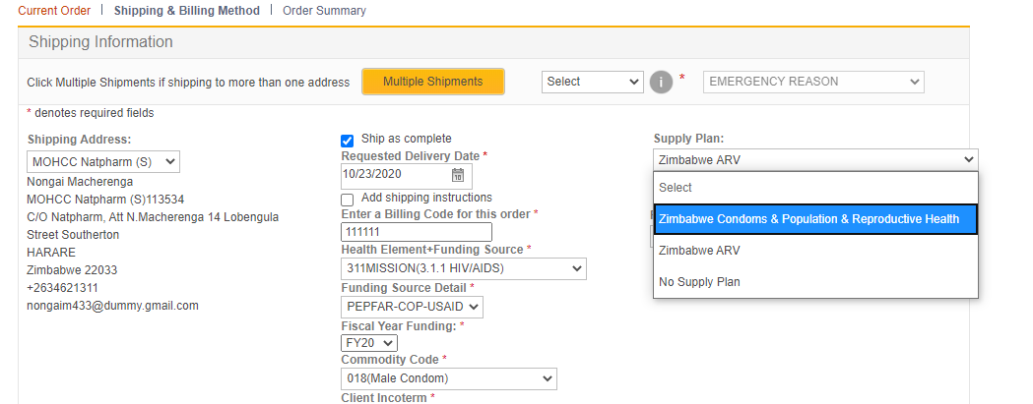
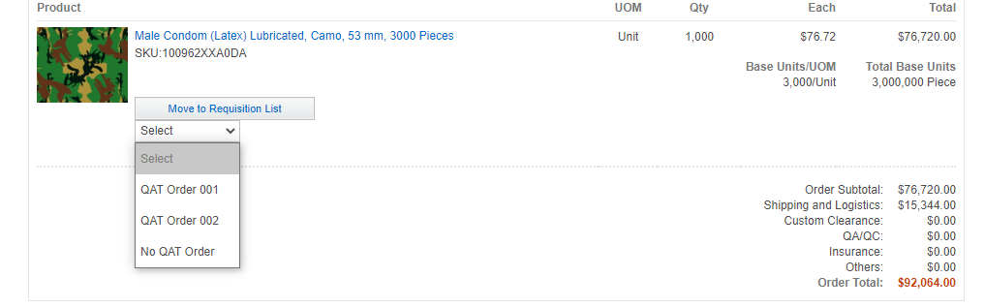
ARTMIS (WebSphere Commerce)
CR 2601
Header level tagging
(data from interface 1 – include inactives, flows into interface 5 and 6?)
Filtered by country
(<~10)
Line-level
Tagging
(data from interface 2, flows into interface 5 and 6?)
Filtered by supply plan & SKU
(<~5)

Slide 5

QAT-ARTMIS Interfaces
Link to tracker on sharepoint
1. QAT Program ID (aka Supply Plan IDs)
CR 2601: ARTMIS pulling in #1 and #2 into WCS
2. QAT Shipment IDs (for ARTMIS line-level tagging)
3. QAT Supply Plans (consumption, shipment, inventory)
#1/#2 are needed to link ARTMIS & QAT data (so QAT can utilize #5/6)
4. ARTMIS Product Catalog
CR2488
5/6. ARTMIS Orders/Shipments
(to display latest shipment status in QAT
Includes QAT program ID & QAT shipment IDs)
CR2489
I have no idea what CR2491_WCSIIBODS FASP Modernization_WCS Draft Order Creation does, so didn’t know where it fit in diagram
2559 is parent CR number for 2488+2489+2490+2491

Slide 6
Process & Data Flow
Q A T
1. Country X Supply Planner plans shipments¹ linked to a specific QAT program
2. Country X Mission/Procurement Specialist places RO
(tagging header to QAT supply plan & line-level to QAT shipment ID)
3. GSC procurement process
(data flows from WCS to OMS², source determined, vendor-specific SKU assigned, etc)
4. Country X Supply Planner sees live status updates
(ARTMIS data shown in QAT, Original QAT planned data hidden)
e.g. Within QAT program KENNTLMAL:
^{QAT order #1231}
^{QAT order #1232}
^{QAT order #1233}
^{QAT order #1234}
e.g. RO #10006789 is linked to KENNTLMAL
RO #10006789-1 tagged to QAT #1231
RO #10006789-2 tagged to QAT #1232
RO #10006789-3 tagged to QAT #1233
RO #10006789-4 tagged to QAT #1234
e.g. RO #10006789 is linked to KENNTLMAL
RO #10006789-1 (QAT #1231) – no change
RO #10006789-2 (QAT #1232) – no change
RO #10006789-3 (QAT #1233) – no change
^{RO #10006789-4 splits into}
RO #10006789-5 (tagged to QAT #1234)
RO #10006789-6 (tagged to QAT #1234)
¹ Each QAT shipment is one delivery date
² Tagging Data is not editable after enters OMS (RO approved by USAID)

Slide 7
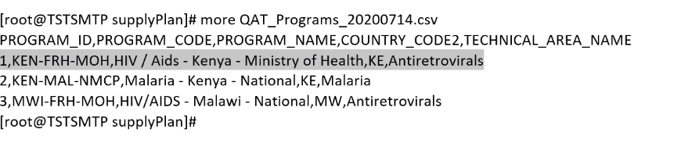
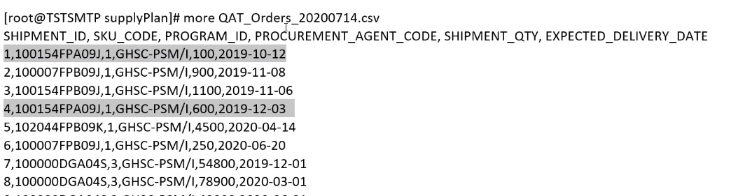
1. QAT Program ID (aka Supply Plan IDs)
FHI/Altius: Need to add
Active/inactive
2. QAT Order IDs (for ARTMIS line-level tagging)

Slide 8
ARTMIS does not have an ID that follows a shipment from beginning to end
Example of RO prime line changes throughout order
Was linked but is now Deactivated
Currently Linked to QAT Shipment
1.
QAT ID | RO Number | RO Line no | Order no | Prime Line no | Parent RO | Old Line no* | QAT Order Id | Product | Qty | Status
12345 | RO10000003 | 1 | RO10000003 | 1 |  |  | A19019 | MPL10100 | 50000 | Active | RO + Line no that we want to link to QAT
No QAT ID | RO10000003 | 2 | RO10000003 | 2 |  |  |  | ADFASDF | 100000 | Active
2.
QAT ID | RO Number | RO Line no | Order no | Prime Line no | Parent RO | Old Line no | QAT Order Id | Product | Qty | Status | <-
12345 | RO10000003 | 1 | RO10000003 | 1 |  |  | A19019 | MPL10100 | 50000 | Deactive | Line gets replaced
No QAT ID | RO10000003 | 2 | RO10000003 | 2 |  |  |  | ADFASDF | 100000 | Active
12345 | RO10000003 | 3 | RO10000003 | 3 |  | 1 | A19019 | MPL10100 | 50000 | Active
3.
QAT ID | RO Number | RO Line no | Order no | Prime Line no | Parent RO | Old Line no | QAT Order Id | Product | Qty | Status | <-
12345 | RO10000003 | 1 | RO10000003 | 1 |  |  | A19019 | MPL10100 | 50000 | Deactive
No QAT ID | RO10000003 | 2 | RO10000003 | 2 |  |  |  | ADFASDF | 100000 | Active
123456 (parent 12345) | RO10000003 | 3 | RO10000003 | 3 |  |  | A19019 | MPL10100 | 20000 | Active | Split
12347 (parent 12345) | RO10000003 | 4 | RO10000003 | 4 |  | 3 | A19019 | MPL10100 | 30000 | Active
* Not in ARTMIS data – included for illustrative purposes

Slide 9
ARTMIS does not have an ID that follows a shipment from beginning to end
Example of RO prime line changes throughout order
Was linked but is now Deactivated
Currently Linked to QAT Shipment
3.
QAT ID | RO Number | RO Line no | Order no | Prime Line no | Parent RO | Old Line no | QAT Order Id | Product | Qty | Status | <-
12345 | RO10000003 | 1 | RO10000003 | 1 |  |  | A19019 | MPL10100 | 50000 | Deactive
No QAT ID | RO10000003 | 2 | RO10000003 | 2 |  |  |  | ADFASDF | 100000 | Active
12345 | RO10000003 | 3 | RO10000003 | 3 |  |  | A19019 | MPL10100 | 20000 | Active | Split
12345 | RO10000003 | 4 | RO10000003 | 4 |  | 3 | A19019 | MPL10100 | 30000 | Active
4.
QAT ID | RO Number | RO Line no | Order no | Prime Line no | Parent RO | Old Line no | QAT Order Id | Product | Qty | Status | <-
12345 | RO10000003 | 1 | RO10000003 | 1 |  |  | A19019 | MPL10100 | 50000 | Deactive
No QAT ID | RO10000003 | 2 | RO10000003 | 2 |  |  |  | ADFASDF | 100000 | Active
12345 | RO10000003 | 3 | RO10000003 | 3 |  |  | A19019 | MPL10100 | 20000 | Deactive
12345 | RO10000003 | 4 | RO10000003 | 4 |  |  | A19019 | MPL10100 | 30000 | Deactive
12345 | RO10000004 | 1 | RO10000004 | 1 | RO10000003 | 3 | A19019 | MPL10100 | 20000 | Active
12345 | RO10000004 | 2 | RO10000004 | 2 | RO10000003 | 4 | A19019 | MPL10100 | 30000 | Active | New RO

Slide 10
ARTMIS (WebSphere Commerce)
CR 2601
Header level tagging
(data from interface 1 – include inactives, flows into interface 5 and 6?)
Filtered by country
(<~10)
Line-level
Tagging
(data from interface 2, flows into interface 5 and 6?)
Filtered by supply plan & SKU
(<~5)

Slide 11
QAT Terminology
QAT Term | Translation/Definition
QAT Program | Supply Plan (e.g. Kenya National HIV)
Planning Unit | ARTMIS Product / 12-digit SKU Used by QAT for planning shipments
Procurement Unit | ARTMIS Item / 15-digit SKU
QAT Order | One shipment – i.e. 1 receipt date, 1 quantity

